Slide 1



GETLIŅI EKO PART
COMMUNICATION OF PROJECT

Slide 2

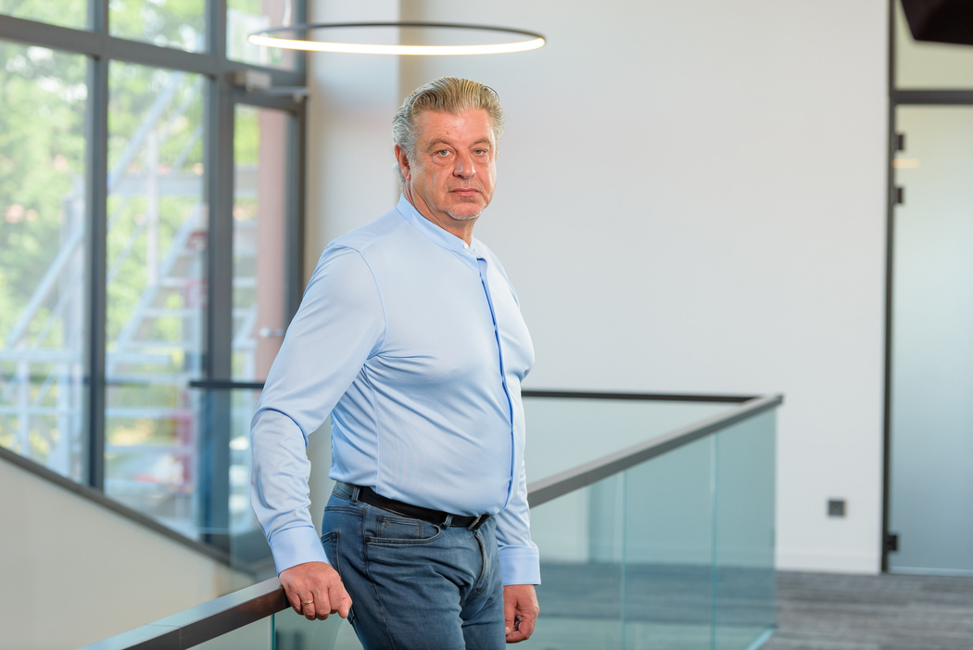
OUR GOALS IN PROJECT
Our goal within the framework of the project is to ensure qualitative information regarding the project's progress on our website, media and social networks. Our communication plan ensures that we reach targeted audiences.
CEO OF GETLIŅI EKO
IMANTS STIRĀNS

Slide 3
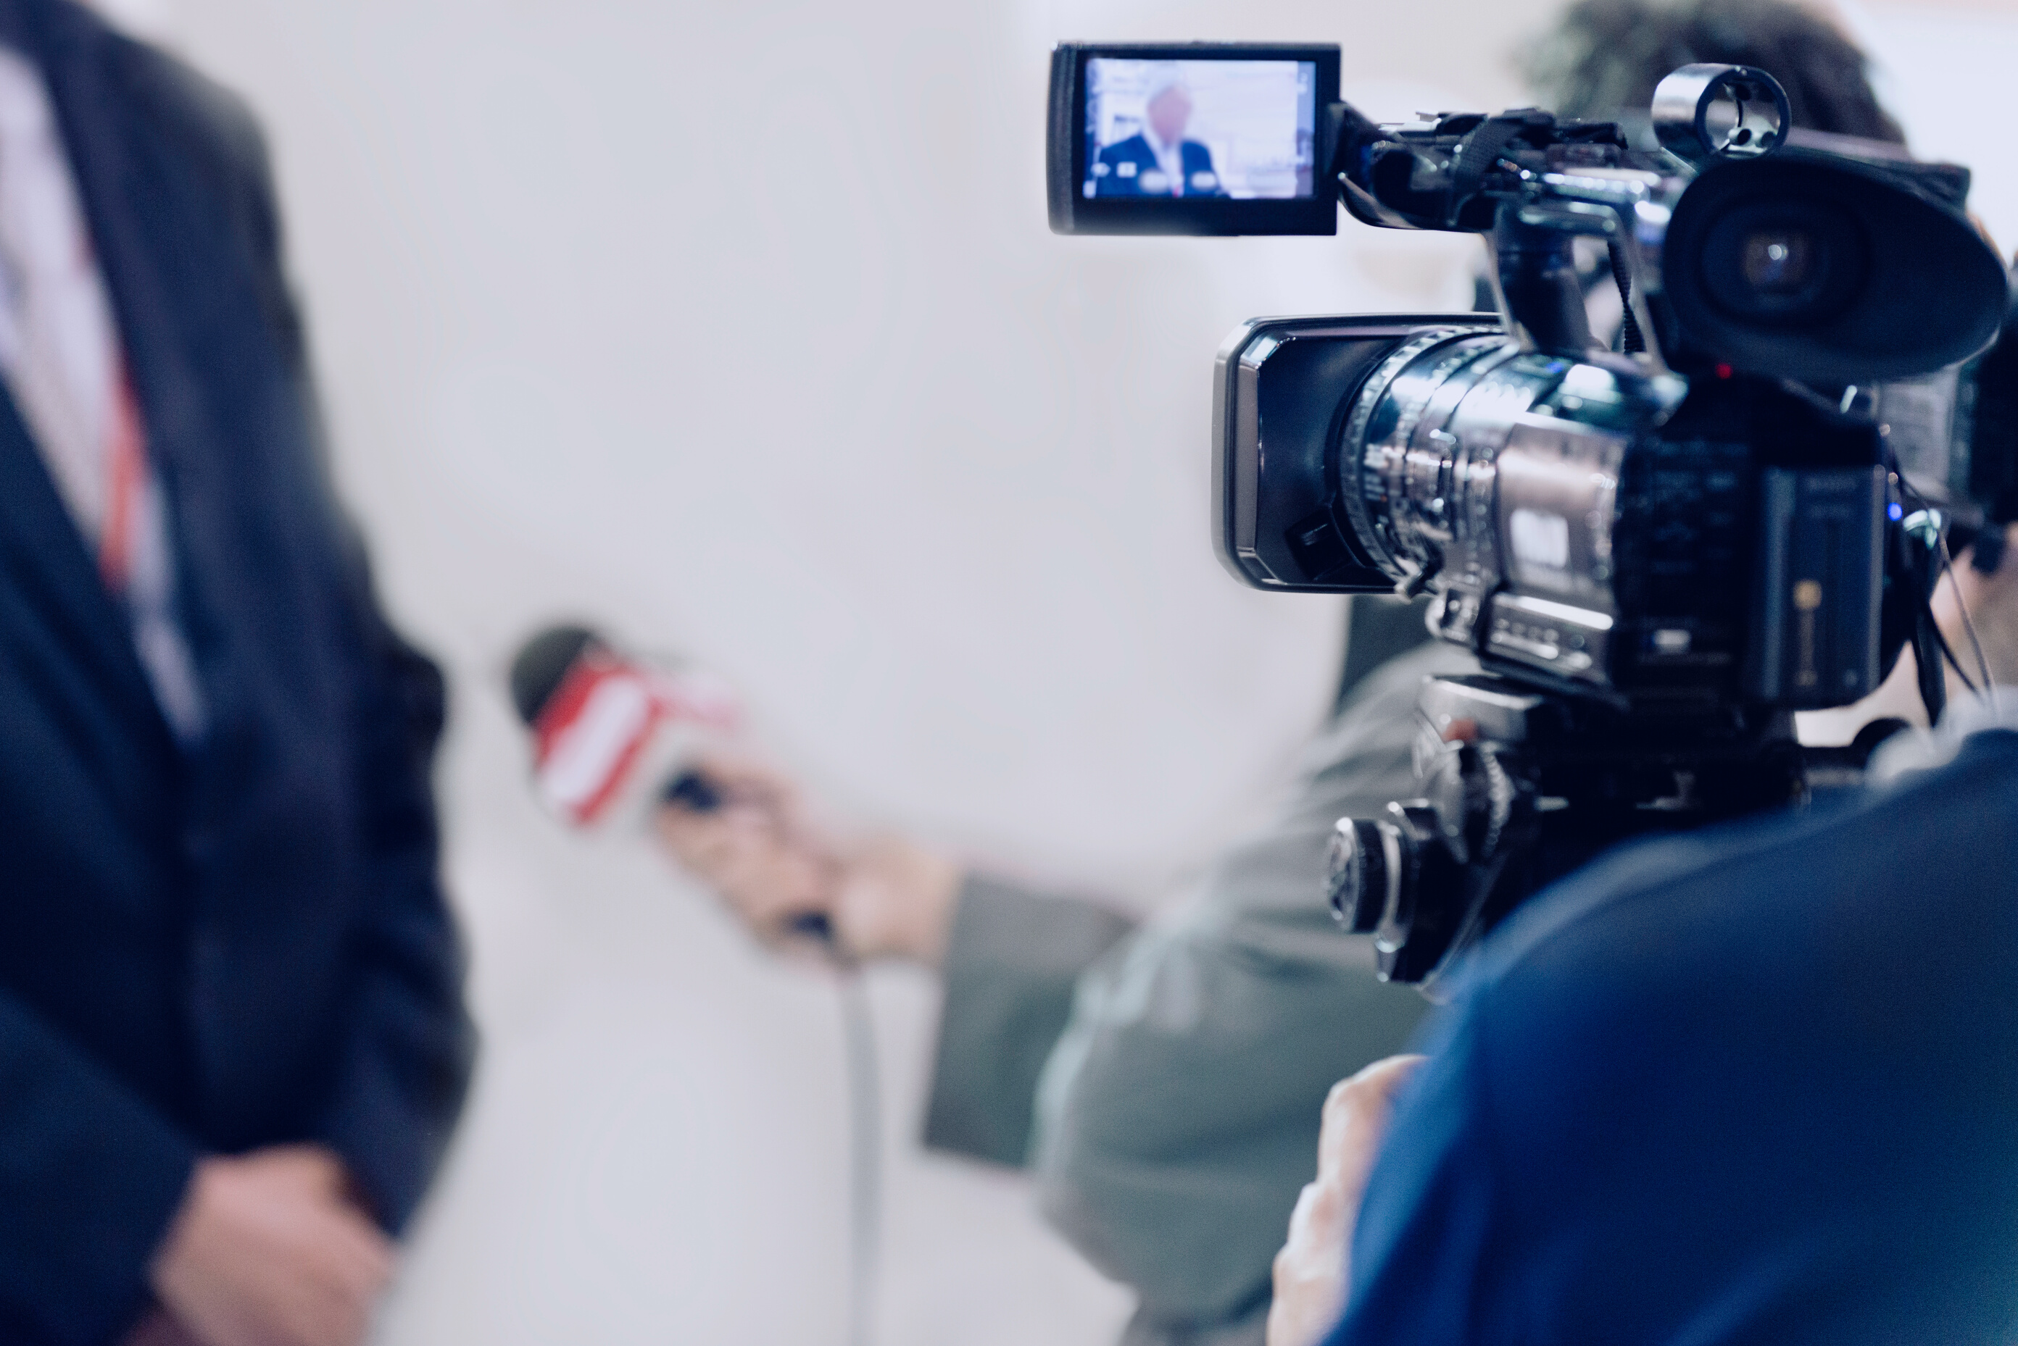
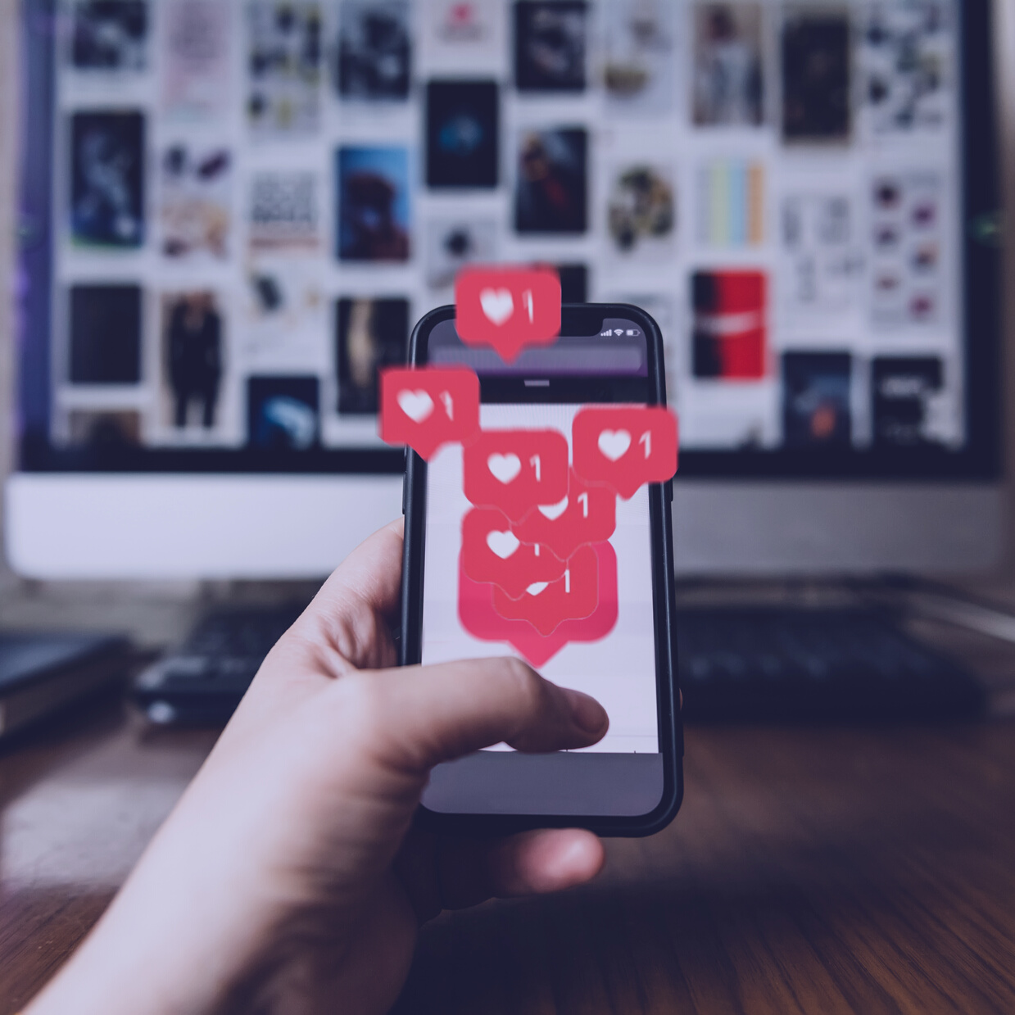
COMMUNICATION PLAN
Good communication plan defines clear objectives (adapted to various relevant target audiences) and set out a description and timing for each activity
1
2
MEDIA RELATIONS
SOCIAL MEDIA
Press releases, opinion articles, interviews
Posts in Facebook, Instagram, LinkedIn and Twitter
3
4
COLAB WITH WASTE MANAGMENT
EVENTS
Participation in industry events, conferences on the subject of our project
Events relating to the progress of projects

Slide 4
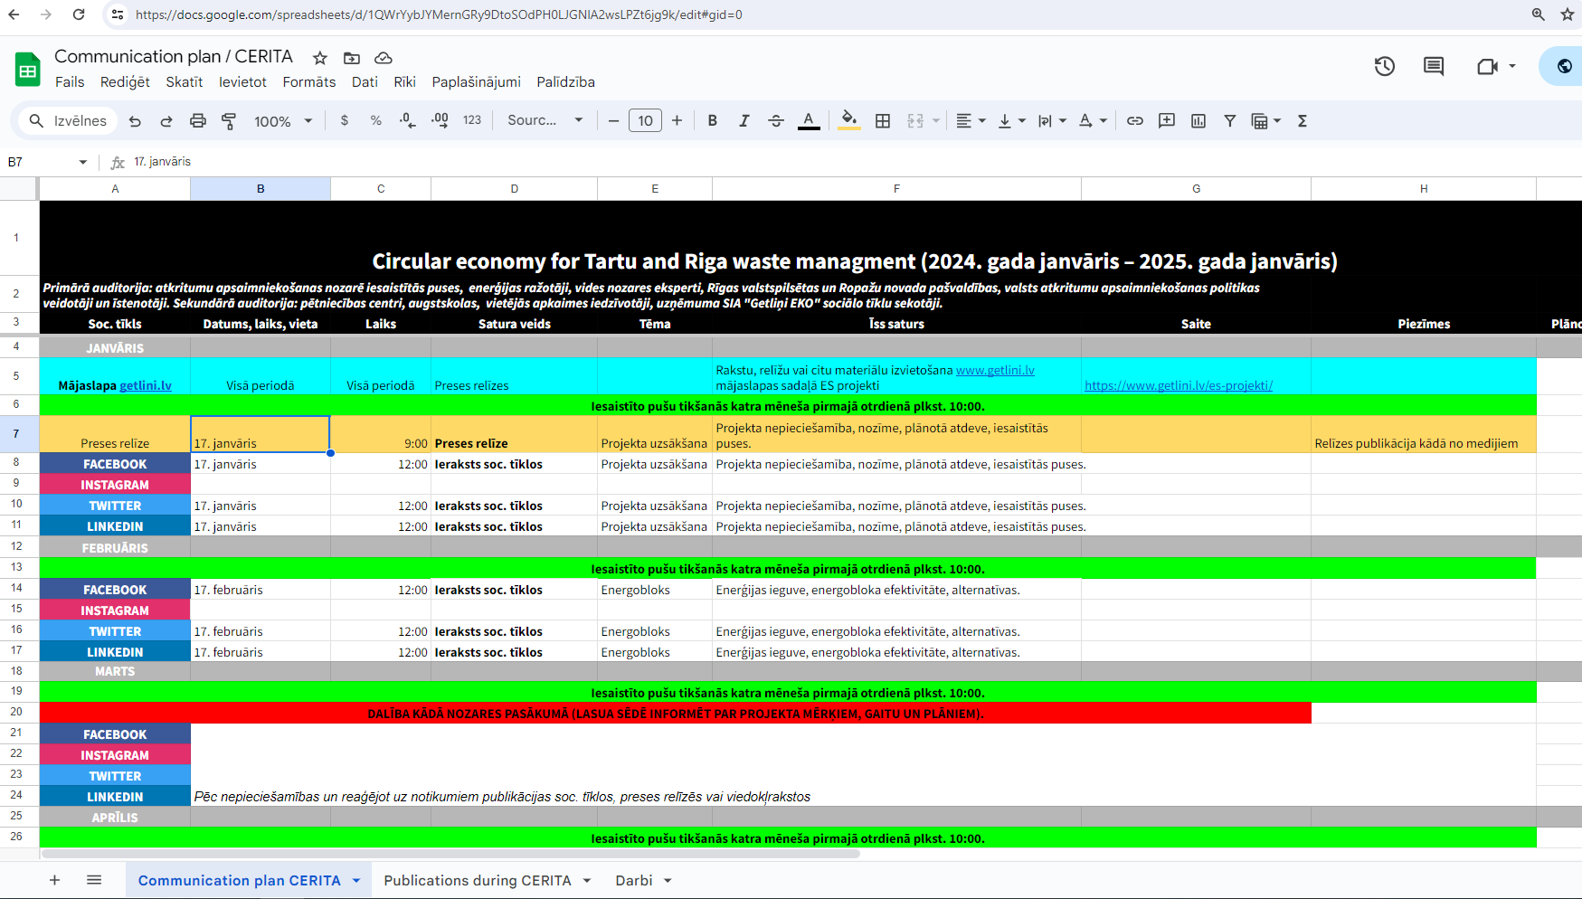






Communication plan online

Slide 5
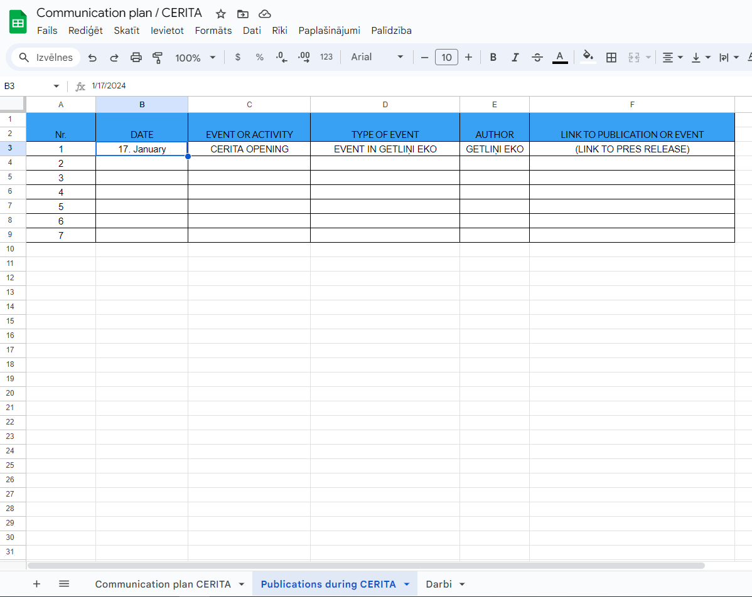

IMPORTANT!
Add your publications online: communication plan - publications during CERITA or send it to Ricards (ricards.ozolins@getlini.lv)
Publications during CERITA

Slide 6

THINGS THAT WE HAVE DONE
COMMUNICATION PLAN
VISUAL IDENTITY
Good communication plan defines clear objectives (adapted to various relevant target audiences) and set out a description and timing for each activity
Logo and presentation template for project
Communication plan online

Slide 7


WHAT TO DO?
If there is something we are proud of and everyone needs to know - inform us!
(press release, opinion article, social media posts, events)
ricards.ozolins@getlini.lv / +371 27128276

Slide 8

GETLIŅI EKO TEAM
Jūlija Daļecka (julija.dalecka@getlini.lv)
Guntis Kampe (guntis.kampe@getlini.lv)
Rūdolfs Kalejs (rudolfs.kalejs@getlini.lv)
Jānis Ozols (janis.ozols@getlini.lv)
Inese Upmale (inese.upmale@getlini.lv)
Kārlis Vonda (karlis.vonda@getlini.lv)
Inese Avota (inese.avota@getlini.lv)
Lilija Dukaļska (lilija.dukalska@getlini.lv)
Ingus Vītiņš (ingus.vitins@getlini.lv)
Ingus Vītiņš (ingus.vitins@getlini.lv)
Artūrs Luzans (arturs.luzans@getlini.lv)
Anete Ivbule (anete.ivbule@getlini.lv)

Slide 9
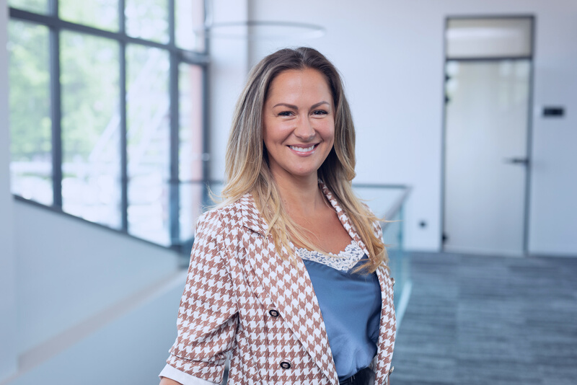
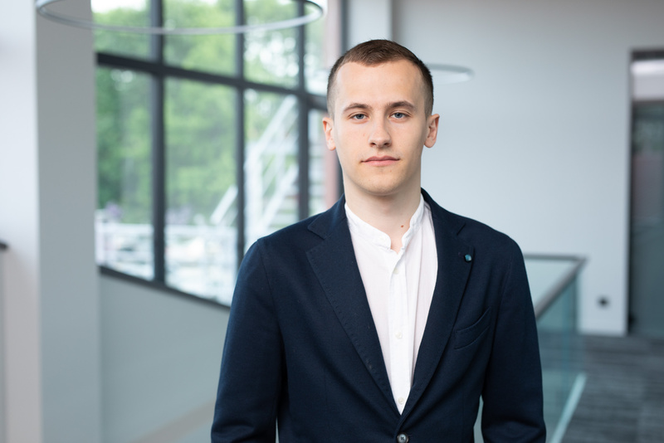
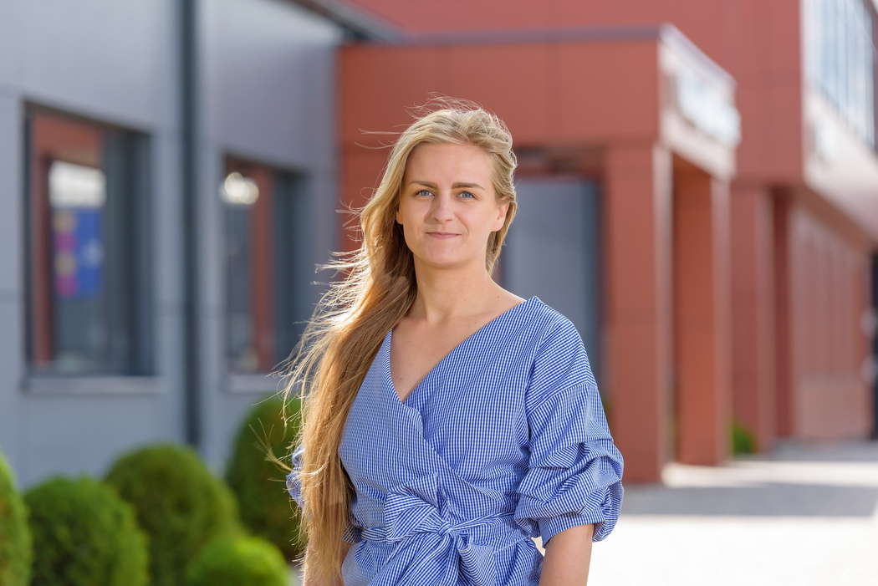
COMMUNICATION TEAM
Head of development and environment
Head of communication
Project manager in environmental education
Līga Šmite (liga.smite@getlini.lv)
Ričards Aksels Ozoliņš
(ricards.ozolins@getlini.lv)
Dārta Grudule
(darta.grudule@getlini.lv)

Slide 10
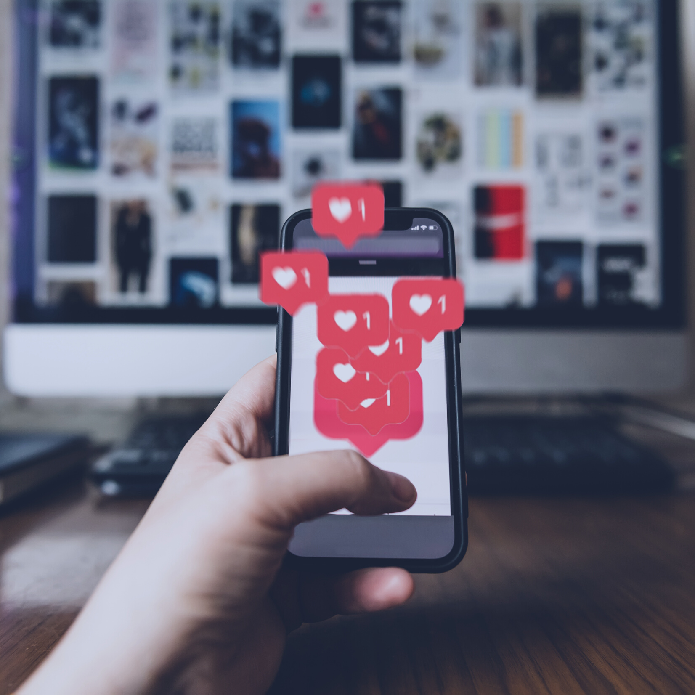
THANK YOU
FOR YOUR ATTENTION

